Slide 1

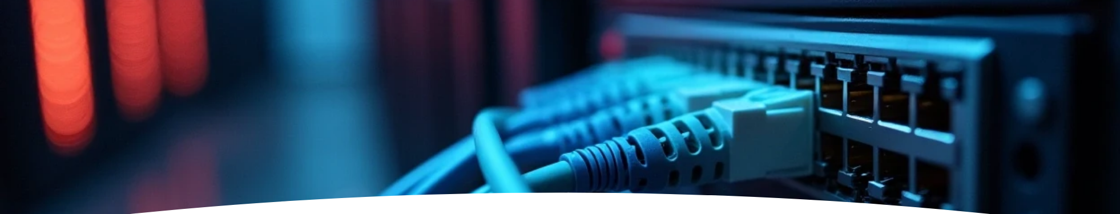

Data Communication and Networks
Networks Protocols and Architecture
Dr. Spoorthi P Shetty
Associate Professor
Department of MCA
NMAM Institute of Technology, Nitte (Deemed to be University)

Slide 2


Need for a Protocol Architecture
Tasks to be performed during the file transfer between two computers are:
The source system must either activate the direct data communication path or inform the communication network of the identity of the desired destination system.
The source system must ascertain that the destination system is prepared to receive data.
The file transfer application on the source system must ascertain that the file management program on the destination system is prepared to accept and store the file for this particular user.
If the file formats used on the two systems are different, one or the other system must perform a format translation function.
In a protocol architecture, the modules are arranged in a vertical stack.
Each layer in the stack performs a related subset of the functions required to communicate with another system.
It relies on the next lower layer to perform more primitive functions and to
conceal the details of those functions.
It provides services to the next higher layer.

Slide 3


Communication Protocols
Communication is achieved by having the corresponding, or peer, layers in two systems communicate.
The peer layers communicate by means of formatted blocks of data that obey a set of rules or conventions known as a protocol.
The key features of a protocol are as follows:
• Syntax: Concerns the format of the data blocks
• Semantics: Includes control information for coordination and error handling
• Timing: Includes speed matching and sequencing

Slide 4

The TCP/IP Protocol Architecture
The TCP/IP protocol architecture is a result of protocol research and development conducted on the experimental packet-switched network, ARPANET, funded by the Defense Advanced Research Projects Agency (DARPA), and is generally referred to as the TCP/IP protocol suite.

Slide 5
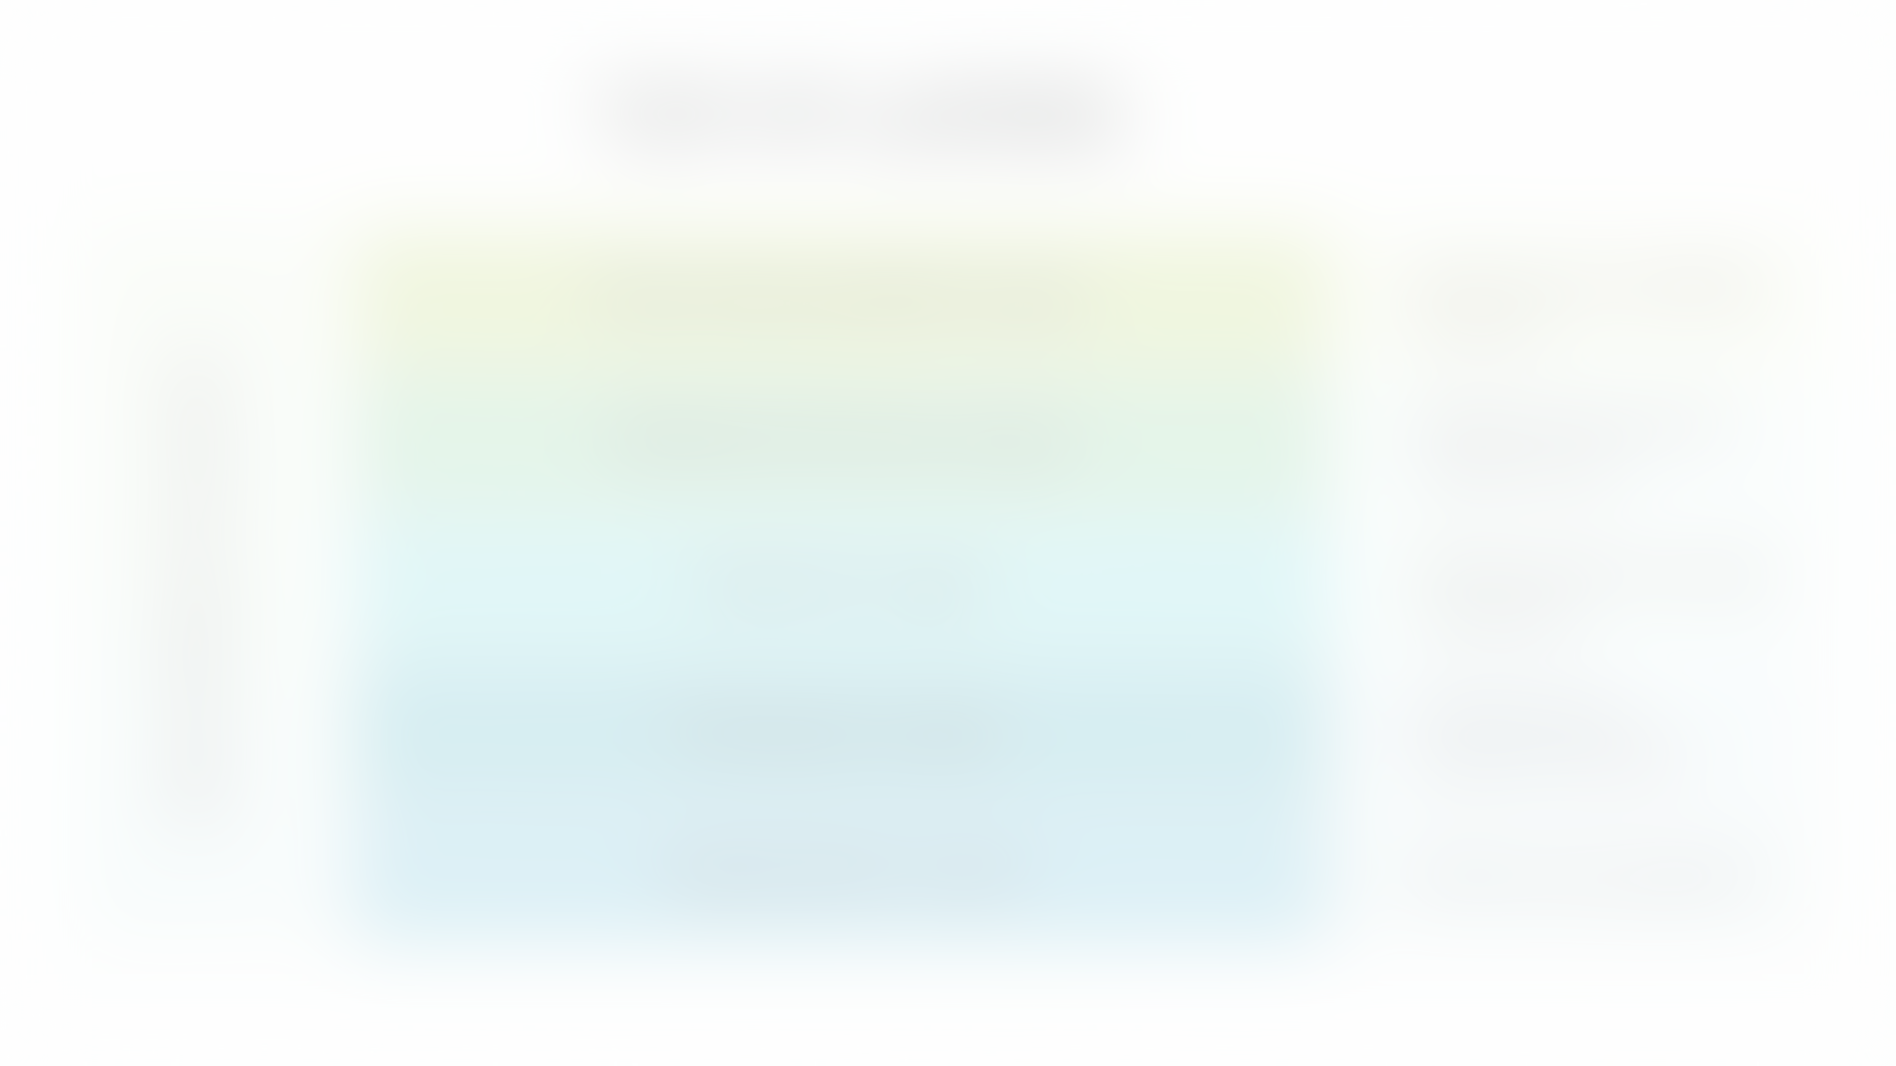
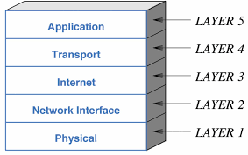
TCP/IP Layers

Slide 6


Application Layer
An application layer is the topmost layer.
This layer allows the user to interact with the application and supports user application.
When one application layer protocol wants to communicate with another application layer, it forwards its data to the transport layer.

Slide 7


Protocols used in Application Layer
HTTP (Hypertext Transfer Protocol): This protocol allows us to access the data over the World Wide Web. It transfers the data in the form of plain text, audio, video.
SNMP (Simple Network Management Protocol): It is a framework used for managing the devices on the internet by using the TCP/IP protocol suite.
SMTP (Simple Mail Transfer Protocol): This protocol is used to send the data to another e-mail address.
DNS (Domain Name System): An IP address is used to identify the connection of a host to the internet uniquely. But, people prefer to use the names instead of addresses. Therefore, the system that maps the name to the address is known as Domain Name System.
TELNET (Terminal Network): It establishes the connection between the local computer and remote computer in such a way that the local terminal appears to be a terminal at the remote system.
FTP (File Transfer Protocol): It is used for transmitting the files from one computer to another.

Slide 8
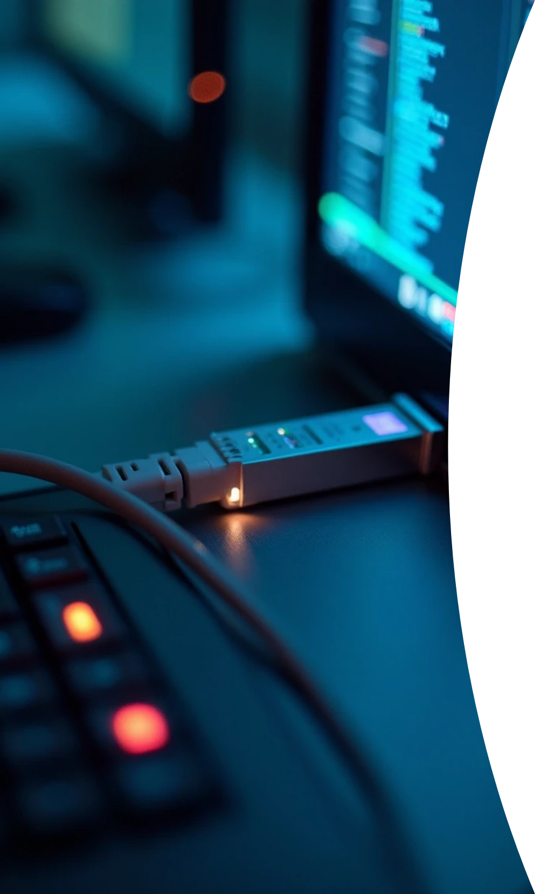
Transport Layer (TCP)
Called as Host-to-Host layer.
Responsible for the reliability, flow control, and correction of data which is being sent over the network.

Slide 9
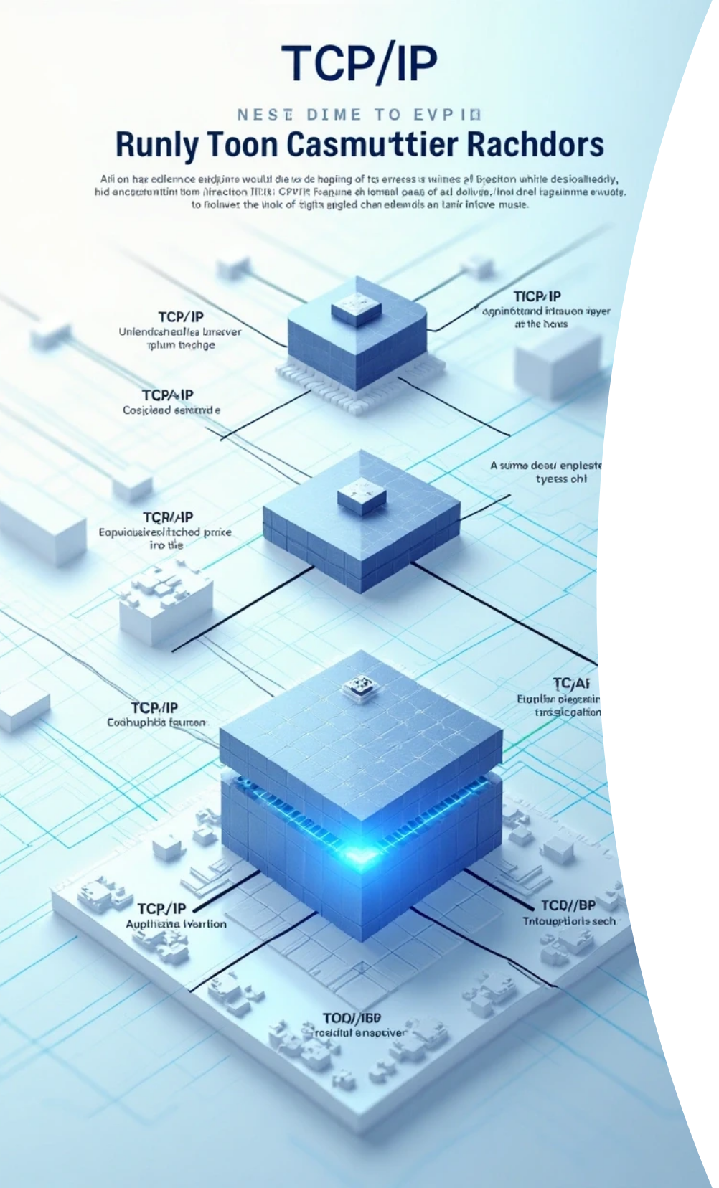


Protocols used
TCP, UDP
Application layer generates a block of data and passes this to TCP.
TCP may break this block into smaller pieces to make it more manageable.
.
To each of these pieces, TCP appends control information known as TCP header
Data + TCP header= TCP segment

Slide 10

TCP Header Includes:
Destination port: When the TCP entity at B receives the segment, it must know to whom the data are to be delivered.
Sequence number:TCP numbers the segments that it sends to a particular destination port sequentially, so that if they arrive out of order, the TCP entity at host B can reorder them.
Checksum (Error detection code): The sending TCP includes a code that is a function of the contents of the remainder of the segment. The receiving TCP performs the same calculation and compares the result with the incoming code. A discrepancy results if there has been some error in transmission.

Slide 11



Internet Layer (IP)
1
2
3
4
5
Concerned with routing data across multiple interconnected networks using IP protocol.
Routers connect two networks and relays data between them.
TCP hands each segment over to IP.
IP appends a header of control information to each segment to form an IP datagram.
TCP segment + IP header=IP datagram
IP header includes the destination host address.

Slide 12

Network Access Layer
Exchange of data between 2 end systems in the same network.
IP datagram is presented to the network access layer.
The network access layer appends its header, creating a packet/frame.
The packet header includes:
• Destination subnetwork address: The subnetwork must know to which attached device the packet is to be delivered.
• Facilities requests: The network access protocol might request the use of certain subnetwork facilities, such as priority.

Slide 13
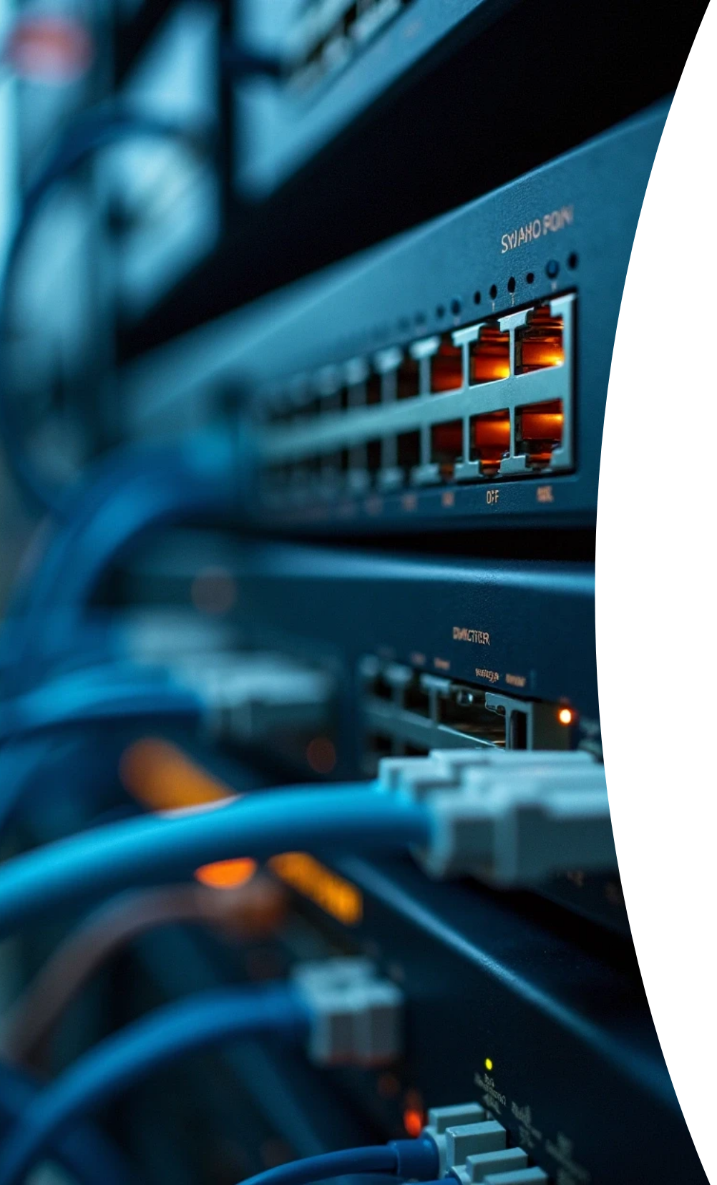
Physical Layer
Concerned with physical interface between computer and network.
Concerned with issues like:
• Characteristics of transmission medium
• Signal levels
• Nature of signal
• Data rates
• Other related matters

Slide 14
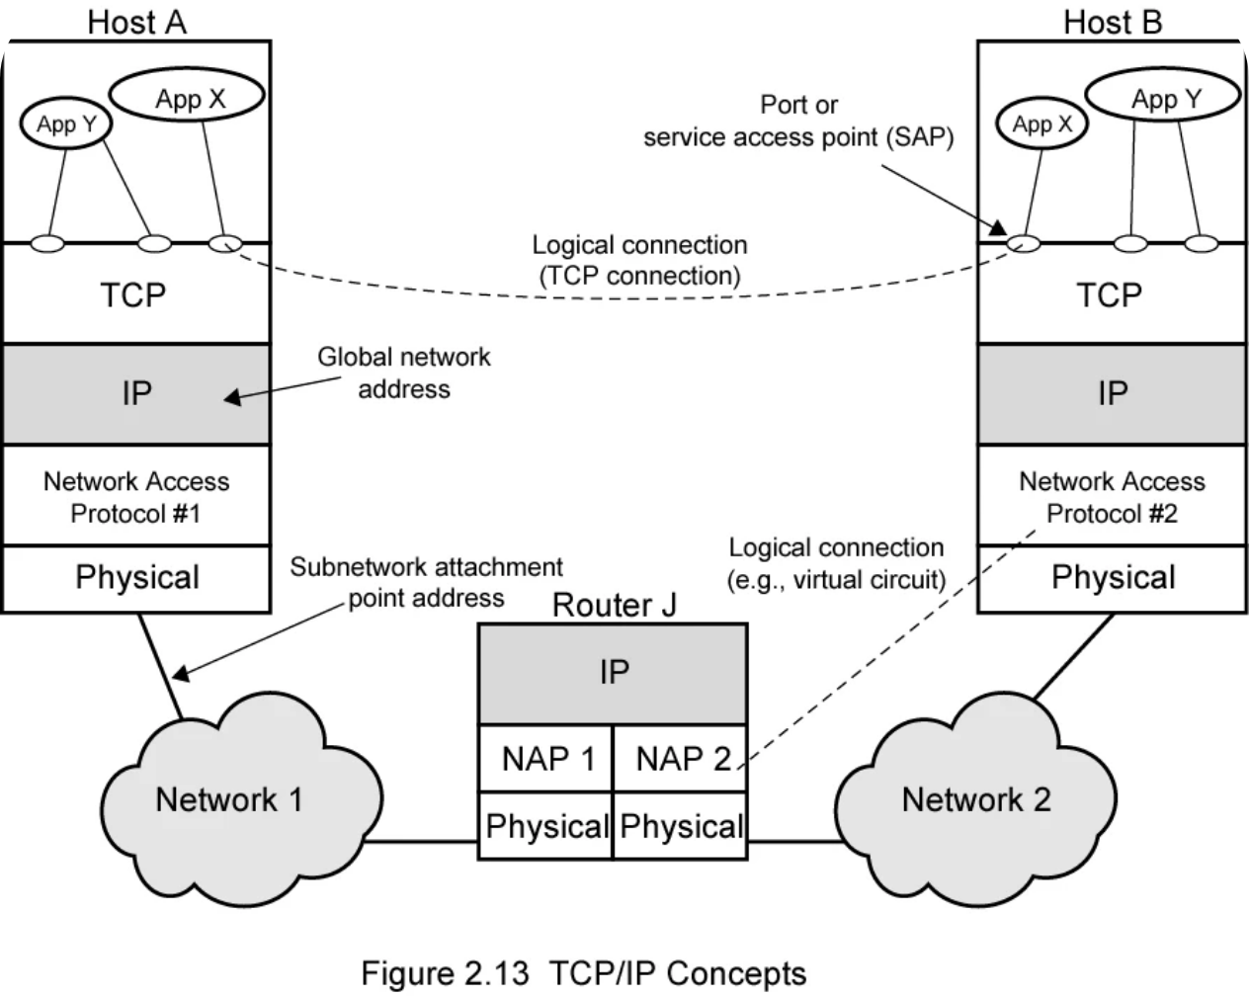
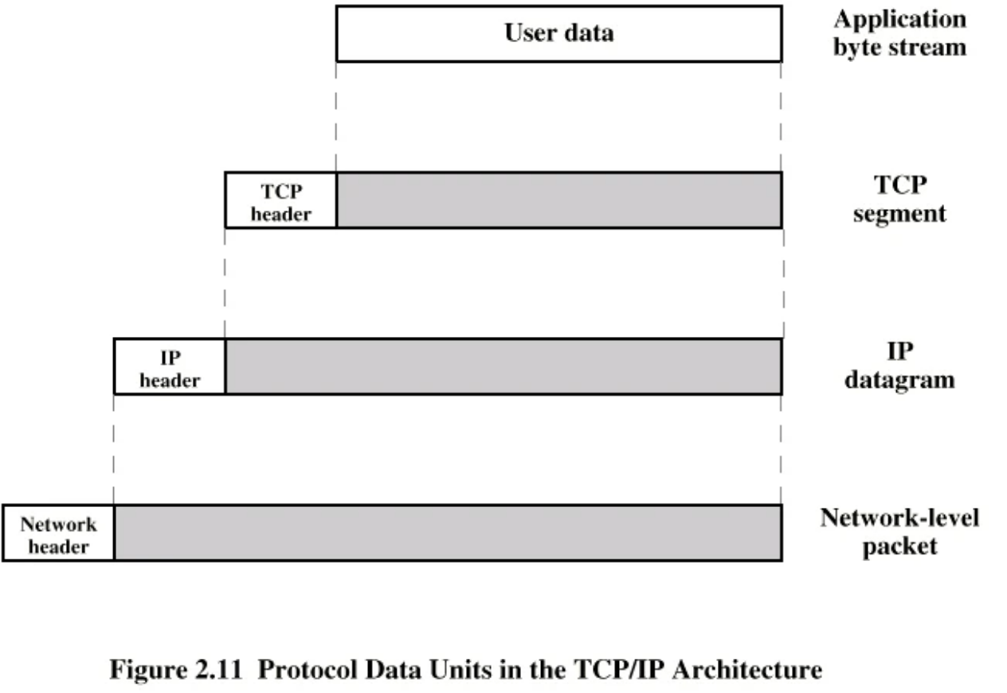
Operation of TCP/IP

Slide 15
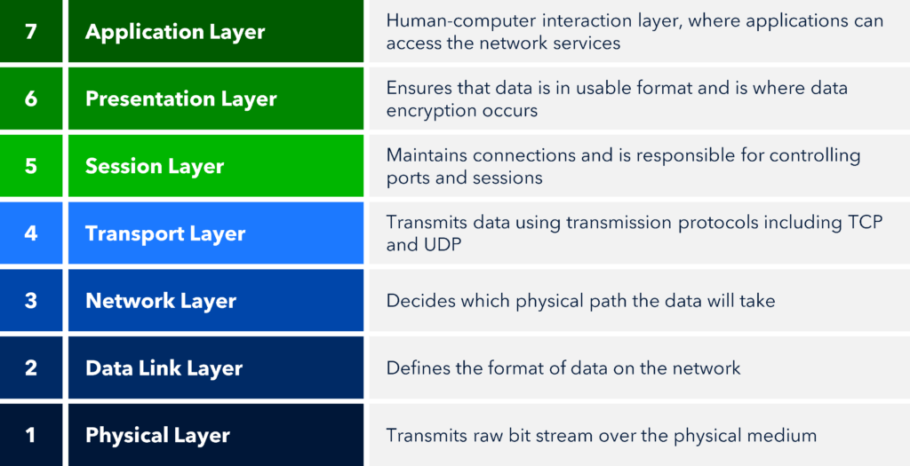
The OSI Model
The Open Systems Interconnection (OSI) reference model was developed by the International Organization for Standardization (ISO).

Slide 16
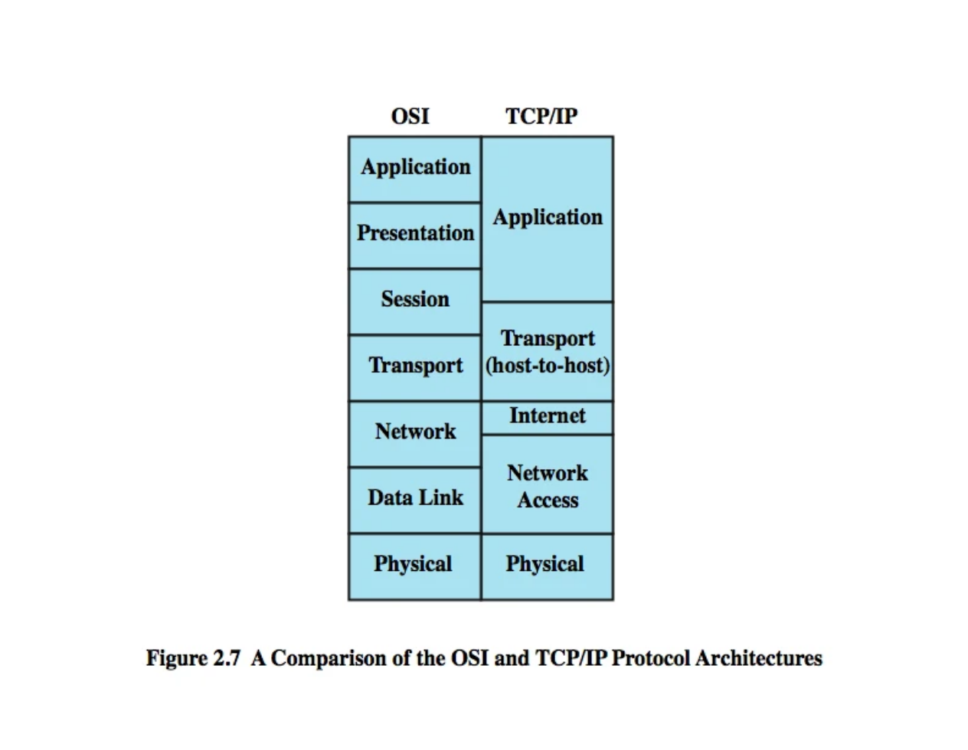
The OSI Model vs TCP/IP Model

Slide 17

Thank You

